Slide 1
In situ Burning (ISB)
CGPRT(W) : Ensuring Clean Seas and Coasts in Western Region ……

Slide 2
Objective
So understand the use of In Situ Burning (ISB) as a possible oil spill response technique
To understand what equipment may be required for an ISB operation
CGPRT(W) : Ensuring Clean Seas and Coasts in Western Region ……

Slide 3
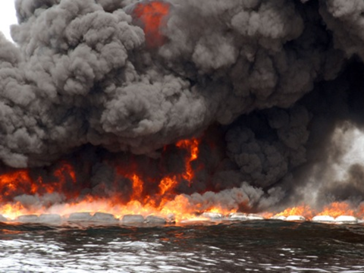
In Situ Burning − ISB
CGPRT(W) : Ensuring Clean Seas and Coasts in Western Region ……

Slide 4
In Situ Burning − ISB
In situ burning is a potential response technique
The principle is to combust vapours from slicks on a water or land surface
This converts the hydrocarbon mixture into CO₂ and water with some particulate (soot) which is then released into the atmosphere leaving a relatively small amount of residue
It has been used on small inland and onshore spills in North America since the late 1950s
CGPRT(W) : Ensuring Clean Seas and Coasts in Western Region ……

Slide 5
In Situ Burning − ISB
ISB operations can be conducted on land, ice or other hard surfaces, or on water
Like any response technique the effectiveness, efficiency and success rates are dependent on:
The type and properties of the oil
The amount of weathering that has occurred
The amount of oil and area covered
The response time and equipment availability
The current and forecasted weather and sea state
CGPRT(W) : Ensuring Clean Seas and Coasts in Western Region ……

Slide 6
In Situ Burning operations
All ISB operations require:
Sufficient fuel to generate an ignitable concentration of vapours (the vapour burns rather than the liquid)
An ignition source to instigate the burn
Sufficient quantities of fuel (i.e. at least 2−3 mm oil thickness) to sustain a burn
Herding agents, if allowed, may be considered to increase the oil thickness
Specialist training and operators
Means of measuring the air and water quality
CGPRT(W) : Ensuring Clean Seas and Coasts in Western Region ……

Slide 7
In Situ Burning − Effectiveness
The potential effectiveness of the burn can be assessed by reference to:
Burnability
The relative ease or difficulty in igniting and sustaining the burn
Relative speed of flame spreading
How quickly the flame will spread though the slick
Estimates of oil removal
Effectiveness or removal rate of the product from the surface
CGPRT(W) : Ensuring Clean Seas and Coasts in Western Region ……

Slide 8
In Situ Burning − Effectiveness
Burn rate
The rate at which the slick is consumed
Sootiness of the flame
The amount of soot (dark smoke) that is likely to be produced. High levels of soot indicate incomplete combustion or indicate the chemical structure of the product being burned.
Relative ease of ignition
A subjective measure of the likelihood of ignition.
This can help determine whether additional products (primers) may be needed to ignite the vapours.
It can also determine the type of igniter needed.
CGPRT(W) : Ensuring Clean Seas and Coasts in Western Region ……

Slide 9
Typical ISB Guide
Oil Type | API Range | Typical Burnability | Relative Speed of Flame Spreading | Estimates (%) of Oil Removal | Burn Rate (mm/min) | Sootiness of Flame | Relative Ease of Ignition
Gasoline | 58 – 74 | Very High | Rapid | 95 – 99 | 4 – 3.5 | Medium | Very Easy
Diesel | 35 – 40 | High | Moderate | 90 – 98 | 3.5 – 2.9 | Very High | Easy
Light Crude | 31 | High | Moderate | 85 – 98 | 3.5 | High | Easy
Medium Crude | 22 – 31 | Moderate | Moderate | 80 – 95 | 3.5 | Medium | Easy
Heavy Crude | < 22 | Moderate | Moderate | 75 – 90 | 3 | Medium | Medium
Weathered Crude | n/a | Low | Slow | 50 – 90 | 2.8 – 2 | Low | Difficult, primer may be required
Crude with Ice | 22 – 31 | Low | Slow | 50 – 90 | 2 | Medium
Light Fuel Oil | 17 – 28 | Low | Slow | 50 – 80 | 2.5 | Low
Heavy Fuel Oil | 14 – 18 | Very Low | Slow | 40 – 70 | 2.2 | Low
Waste Oil | n/a | Low | Slow | 30 – 60 | 2 | Medium
Emulsified Oil | n/a | Low | Slow | 30 – 60 | 2 - 1 | Low
Source: Fingas 2011, IPIECA-IOGP Guidelines for the selection of ISB equipment
CGPRT(W) : Ensuring Clean Seas and Coasts in Western Region ……

Slide 10
ISB – Case Histories
Incident | Oil Type | Year | Location | Source | Habitat | Burn Effectiveness (%) | Description
Burmah Agate | Nigerian Crude | 1979 | Offshore | Tanker collision | Open water | 46.7 | Two tanks ruptured, resulted in explosions, the vessel continued to burn for 2 months.
YUM II / Zapoteca | Light Crude | 1987 | Offshore | Offshore well blow out | Open water | Up to 90% | Exploratory oil well blowout and fire. 6 day controlled burn.
Exxon Valdez | North slope crude | 1989 | Coastal Bay | Tanker release | Open water | 98 | Fire boom used.
Chiltipin Creek | Light Crude | 1992 | Inland | Under- ground pipeline release | Salt marsh | 80 - 85 | Weathered.
Source: IPIECA-IOGP Guidelines for the selection of ISB equipment
CGPRT(W) : Ensuring Clean Seas and Coasts in Western Region ……

Slide 11
ISB – Case Histories
Incident | Oil Type | Year | Location | Source | Habitat | Burn Effectiveness (%) | Description
Rockefeller Refuge | Condensate | 1995 | Inland | Pipeline | Brackish marsh | > 80 | Weathered 4 days.
Lakehead pipeline spill (Ruffy Brook) | Bow River crude oil | 2000 | Inland | Pipeline | Fresh -water marsh | 80 | Mechanical recovery deemed too difficult and potentially damaging. Residue collected by hand.
Northern Utah pipeline burn | Diesel Fuel | 2000 | Upland | Pipeline | Salt flat and wetlands | 75 - 80 | Approximately 45 days of weathering.
Mosquito Bay | Condensate | 2001 | Inland | Pipeline | Brackish coastal marsh | 99 | Weathered 7-8 days prior to ISB.
Source: IPIECA-IOGP Guidelines for the selection of ISB equipment
CGPRT(W) : Ensuring Clean Seas and Coasts in Western Region ……

Slide 12
ISB – Case Histories
Incident | Oil Type | Year | Location | Source | Habitat | Burn Effectiveness (%) | Description
Bayou Tank Battery | Crude oil | 2002 | Inland | Tank farm release | Marsh | 90 - 98 | Fresh oil burned. Removal of residue proved difficult.
Chevron Empire Facility | Louisiana sweet crude | 2005 | Inland | Tank farm release | Brackish coastal marsh | 80 - 90 | Based on visual observations.
Deepwater Horizon | Louisiana sweet crude | 2010 | Offshore | Offshore well blow-out | Open water | 99 | Approximately 400 controlled burns were conducted removing an estimated 35,000 – 49,000 m³
Source: IPIECA-IOGP Guidelines for the selection of ISB equipment
CGPRT(W) : Ensuring Clean Seas and Coasts in Western Region ……

Slide 13
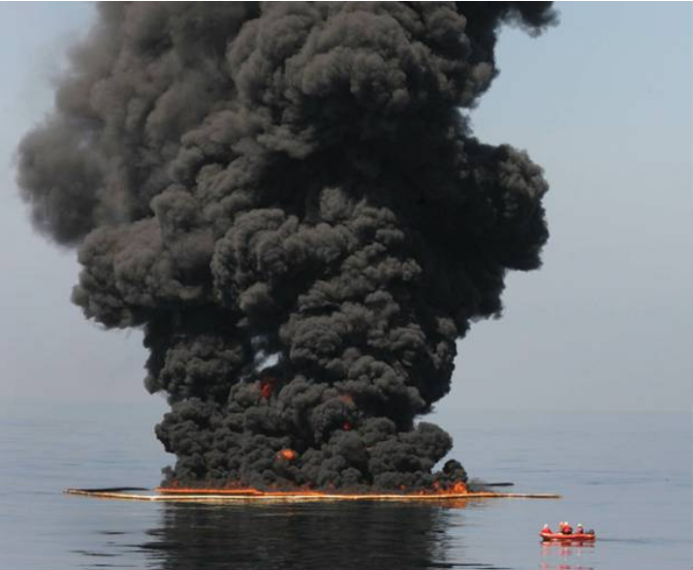
Deepwater Horizon
Source: USCG
CGPRT(W) : Ensuring Clean Seas and Coasts in Western Region ……

Slide 14
Equipment Required
The amount and types will depend on the circumstances of the spill and the scale of the intended burn.
Small-scale burns require less equipment
CGPRT(W) : Ensuring Clean Seas and Coasts in Western Region ……

Slide 15
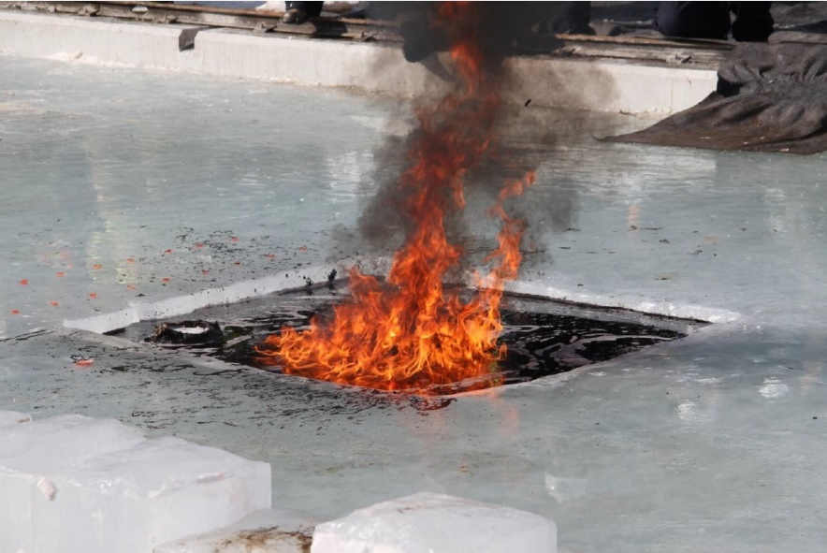
Equipment Required
Onshore:
Trenching equipment or shovels to provide a collection basin
Igniter
Fire control
Air quality monitoring
Wind direction and forecast
Personal protective equipment (PPE)
Source: OSRL
CGPRT(W) : Ensuring Clean Seas and Coasts in Western Region ……

Slide 16
Equipment Required
Offshore:
Boom towing vessels
Fire boom
Igniter
Fire control
Air quality monitoring
Wind and sea state and forecast
Aerial surveillance
Personal protective equipment (PPE)
Burn residue recovery resources
CGPRT(W) : Ensuring Clean Seas and Coasts in Western Region ……

Slide 17
ISB Fire Boom Configurations
Boom
“U” with feather line or bridle
Tow and feather line
Standard “U”
Towing vessel
Wind direction
3-tow vessel “U” with feather line or bridle
Feather line or bridle at boat
Oil slick
CGPRT(W) : Ensuring Clean Seas and Coasts in Western Region ……

Slide 18
Fire Boom
Fire boom can be classified as either:
Actively-cooled fire resistant boom
Resistance to heat is achieved by pumping water onto the surface of the boom or by wicking water into the boom surface material
Intrinsically fire resistant boom
Resistance to heat is achieved through the use of fire-resistant materials in its construction
CGPRT(W) : Ensuring Clean Seas and Coasts in Western Region ……

Slide 19
Fire Boom
They have a finite life once deployed as integrity will be reduced through repeated burns
Important that:
It will last through the proposed burn operation
That the boom can contain the fire residues
That the boom will remain sufficiently intact so that it can be recovered for disposal
Generally heavier than conventional boom so more prone to failure in higher sea conditions
CGPRT(W) : Ensuring Clean Seas and Coasts in Western Region ……

Slide 20
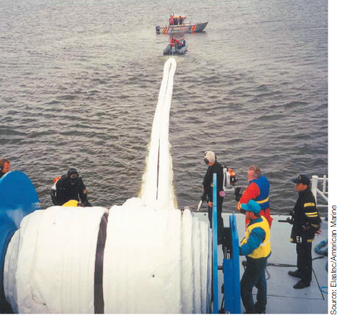
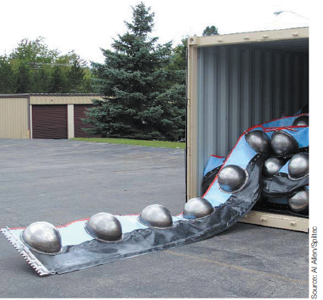
Typical Fire Booms
Source: IPIECA-IOGP
CGPRT(W) : Ensuring Clean Seas and Coasts in Western Region ……

Slide 21
Actively Cooled Fire Boom
Cooling system that uses water pumps and a protective jacket.
Distributes water across the exposed surfaces to provide cooling.
Can be stored on powered reel.
Needs specific training due to ancillary equipment
Reel, air pumps, water pumps.
Source: IPIECA-IOGP Guidelines for the selection of ISB equipment
CGPRT(W) : Ensuring Clean Seas and Coasts in Western Region ……

Slide 22
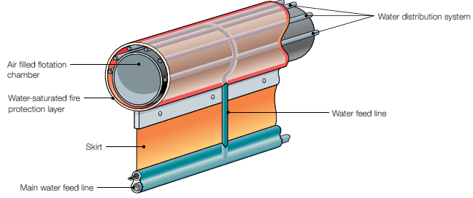
Actively Cooled Fire Boom
CGPRT(W) : Ensuring Clean Seas and Coasts in Western Region ……

Slide 23
Intrinsically Fire-Resistant Boom
Relies upon fire-resistant materials to maintain integrity.
Does not require support systems thus simplifying maintenance and deployment.
Shipped in containers or on pallets.
Deployment and retrieval will rely on manpower and vessel crane, if available.
CGPRT(W) : Ensuring Clean Seas and Coasts in Western Region ……

Slide 24
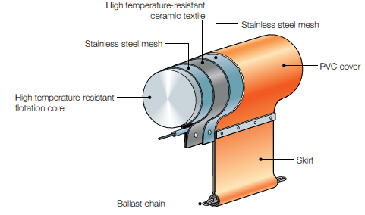
Intrinsically Fire-Resistant Boom
CGPRT(W) : Ensuring Clean Seas and Coasts in Western Region ……

Slide 25
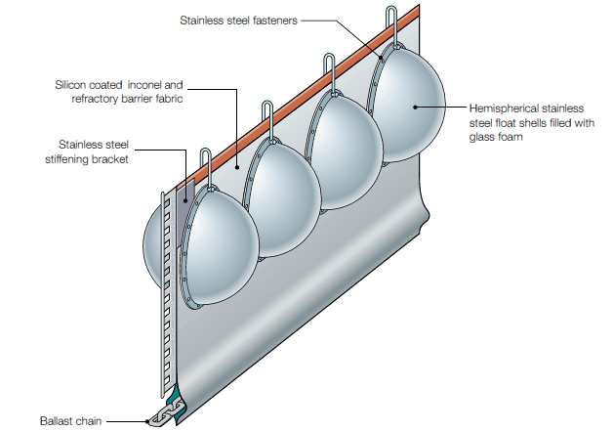
Intrinsically Fire-Resistant Boom
CGPRT(W) : Ensuring Clean Seas and Coasts in Western Region ……

Slide 26
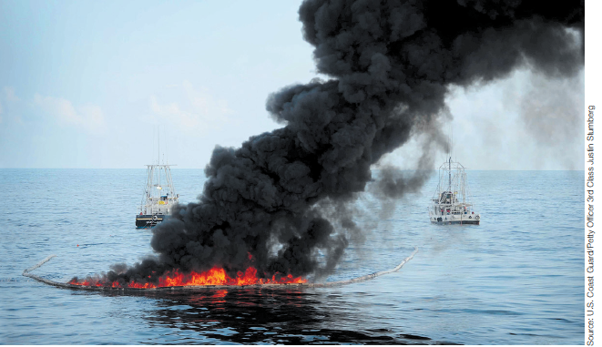
ISB in Operation
CGPRT(W) : Ensuring Clean Seas and Coasts in Western Region ……

Slide 27
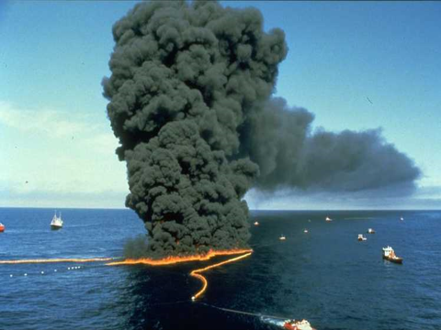
ISB Test
CGPRT(W) : Ensuring Clean Seas and Coasts in Western Region ……

Slide 28
Guidelines for Selecting Fire Boom
Factors |  | Actively Water-Cooled Systems | Intrinsically Fire-Resistant Systems
Storage space on deck | Limited space required (reels) | √
 | Clear deck space required (flaked or zig-zag) | √ | √
Deployment Time | Ongoing operations, deployment time less important | √
 | Small short-term operations |  | √
Deployment Team | Training Required | √√ | √
 | General oil spill response workers |  | √
CGPRT(W) : Ensuring Clean Seas and Coasts in Western Region ……

Slide 29
Igniters
The ease with which ignition will be reached depends on:
The concentration of hydrocarbon vapours
The oil type (flash point and auto-ignition temperature)
The amount of weathering
The ability of an igniter to provide a source of heat for sufficient time to heat the vapours and bring them to ignition
CGPRT(W) : Ensuring Clean Seas and Coasts in Western Region ……

Slide 30
Safe Distance Calculations
Type and Area | Burn Area (Acres) | Safe Distance (km) | Safe distance (miles)
Crude Oil Burns
Small Area (250 m³) | 0.6 | 0.09 | 0.06
Medium Area (500 m³) | 1.2 | 0.5 | 0.3
Large Area (750 m³) | 1.9 | 3.2 | 2
Diesel Burns
Small Area (250 m³) | 0.6 | 0.8 | 0.5
Large Area (500 m³) | 1.2 | 20 | 12.4
CGPRT(W) : Ensuring Clean Seas and Coasts in Western Region ……

Slide 31
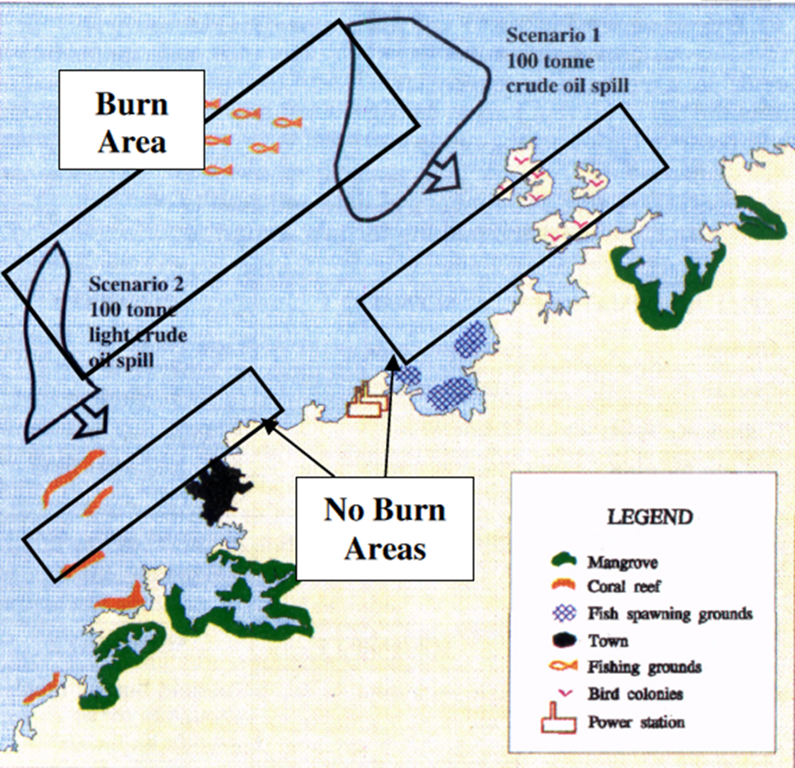
Environmental Risk Assessment
In response operations there is seldom time to carry out formal, detailed risk assessments.
ISB risk assessments should be carried out in the planning phase if ISB operations are considered.
CGPRT(W) : Ensuring Clean Seas and Coasts in Western Region ……

Slide 32
Air Quality Monitoring
If this tactic is to be considered then air quality monitoring needs to be put into place.
On-site monitoring is required for hazardous and flammable/explosion conditions.
Down-wind monitoring is required for public health concerns.
Constant weather monitoring and forecasting should be in place.
Precise locations should be flexible.
CGPRT(W) : Ensuring Clean Seas and Coasts in Western Region ……

Slide 33
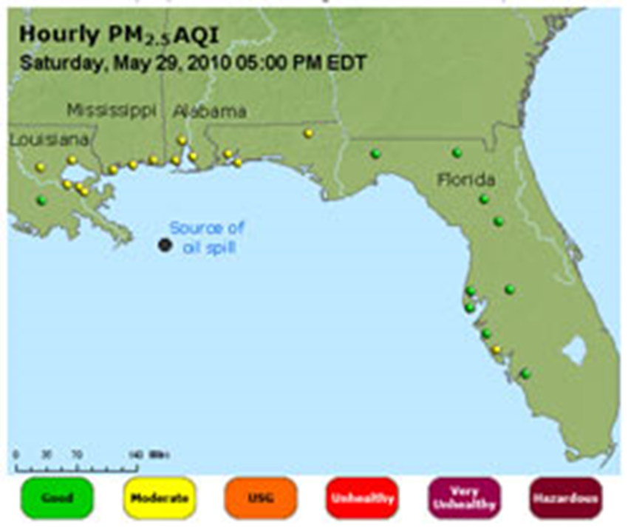
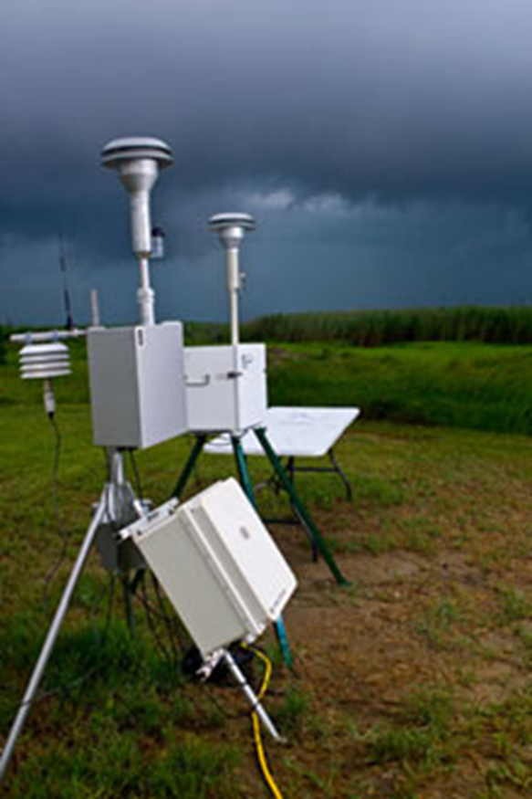
Air Quality Monitoring
US EPA
CGPRT(W) : Ensuring Clean Seas and Coasts in Western Region ……

Slide 34
Tactical Considerations − ISB
In summary:
Is it technically reasonable?
Does it meet our NEBA criteria and considerations?
Is it allowed under our regulations?
Do we have the resources?
Can we monitor the effectiveness?
CGPRT(W) : Ensuring Clean Seas and Coasts in Western Region ……

Slide 35
Incident Management
Command Function
Planning Function
Logistics
Function
Finance Function
Operations Function
Environment
ISB Operations
CGPRT(W) : Ensuring Clean Seas and Coasts in Western Region ……

Slide 36
Summary
ISB may be a response option but depends on a number of key factors:
The oil type
The amount of weathering that has taken place
The current and forecasted weather conditions
The availability of equipment
The ability to carry out the operation safely
The safety of the responders and public
NEBA considerations during planning phase
CGPRT(W) : Ensuring Clean Seas and Coasts in Western Region ……

Slide 37
Any questions?
CGPRT(W) : Ensuring Clean Seas and Coasts in Western Region ……

